Slide 1
Pune Vidyarthi Griha’s College of Engineering & Technology &G. K. Pate (Wani) Institute of Management, Pune DEPARTMENT OF ELECTRONICS AND TELECOMMUNICATION ENGINEERING Academic Year: 2023-2024
A Geo-Intelligent Crop Advisor and Market Prediction System for Farmers
Name of Project Group members
Anushray Pingale
Aditya Chavan
Darshan Pakhale
Tejas Kulkarni
Name of Guide: Prof. A.S.Najan

Slide 2
Objectives of Project :-
To detect the soil type using CNN.
To predict the crops using Random Forest.
To improve the performance of the model.
To predict shops using KNN.
To develop the most effective crop-predicting system using a machine learning algorithm.

Slide 3
Expected Outcomes :-
To recommend the crops.
To recommend the humidity, rainfall, and temperature.
To recommend the industry.
Problem Statement :-
To recommend the crops, humidity, rainfall, temperature, nearest industry using machine learning and deep learning algorithms based on soil image, N, P, K values, pH, season and region.

Slide 4
Literature Survey/Market Survey:-
Title of Paper And Year | Technology/Algorithm used | Results obtained
Soil Classification and suitable Crop Prediction - 2017 | Crop Prediction using Machine Learning | better prediction accuracy than the existing classification technique.
A Compressive Review on soil classification - 2021 | Deep Learning(CNN) | better accuracy of crop prediction
Soil Classification and Crop suggestion - 2020 | KNN algorithm and Bagged tree algorithm | Predict best-suited crop for particular land
Soil Classification and Crop Prediction- 2023 | Convolutional Neural Network | Predict the soil type and suitable crop.

Slide 5
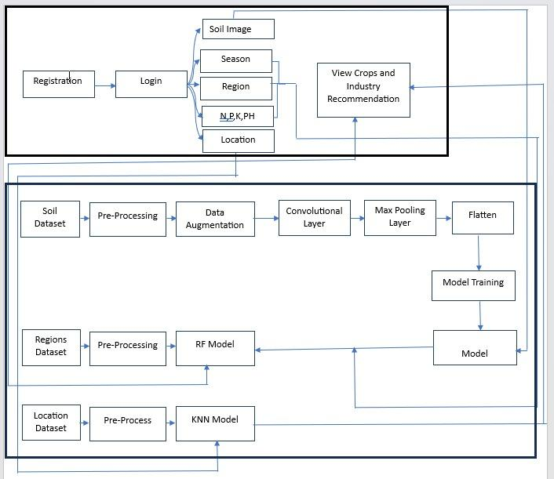
Block Diagram of the System :-

Slide 6
Implementation
A] Dataset Gathering
Every Machine Learning model works on the data.
The dataset gathering is first step of any machine learning or deep learning project.
We have collected the dataset of soil from kaggle platform.
The dataset contains total 817 images of soils which are alluvial, black, clay and Red soil image colors.
We have split the data into two parts:
1] Training
The training folder contains 656 images. Basically the CNN model will learn
the features on training data.

Slide 7
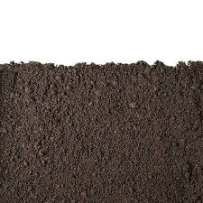
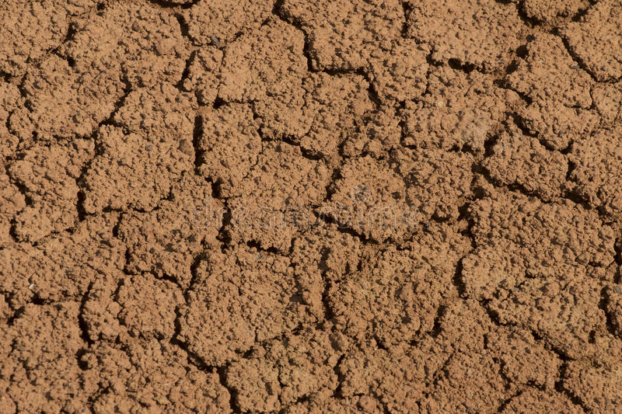
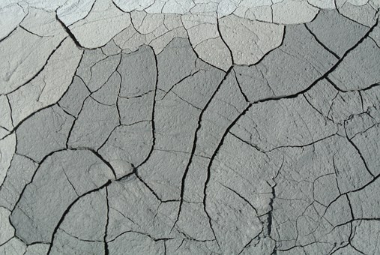
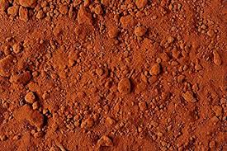
Cont…
2] Testing
The testing folder contains 161 images. This test data will check the performance of
Model on trained data.

Slide 8
Cont...
B] Dataset Pre-Processing
The dataset contains different sizes of every image.
In that we are converted the every image into standard size. i.e. (224*224).
C] Data Augmentation
In this step we are performing some transformations on images such as rotate the
Image into 40 degree/angle, zoom the image with 0.2 scale factor and changing the
Contrast of original image.
D] Model Training
In this step we have trained the model with 100 epochs and we got the 98.23% accuracy.

Slide 9
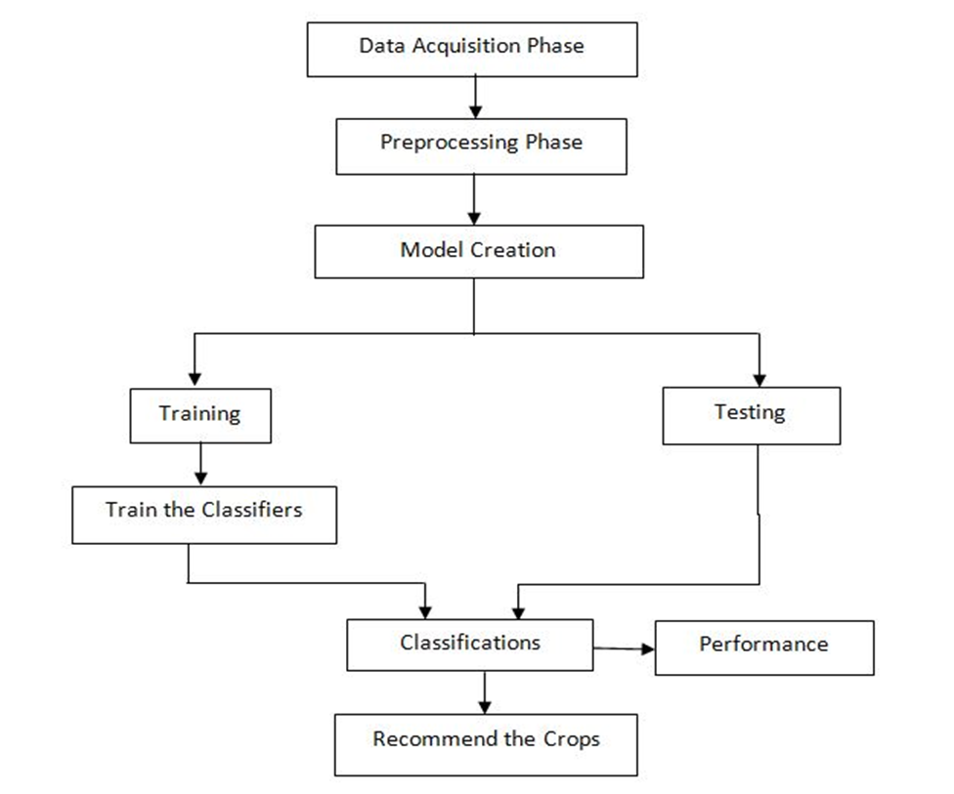
Architecture Diagram :-

Slide 10

Algorithm
Conventional Neural Network (CNN)
CNN takes in processed images as input.
Extracts different features about the images regardless of their position using a series of mathematical operations to identify the pattern.
Every layer in CNN has API which transforms input to output with differentiable functions.

Slide 11

Cont...
Convolutional Layer
Pooling
Flattening
Fully Connection
Figure: CNN Architecture

Slide 12

Cont...
2. Pooling Layer
The function of pooling is to continuously reduce the dimensionality to reduce the number of parameters and computation in the network. This shortens the training time and controls over fitting
Max Pooling extracts out the highest pixel value out of a feature while average pooling calculates the average pixel value that has to be extracted.

Slide 13
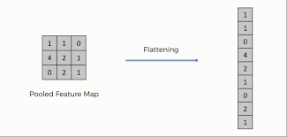
Cont...
3. Flattening
Basically here we arrange the pooled feature into a single vector/column as a input for next layer(convert our 2D data to 1D)

Slide 14
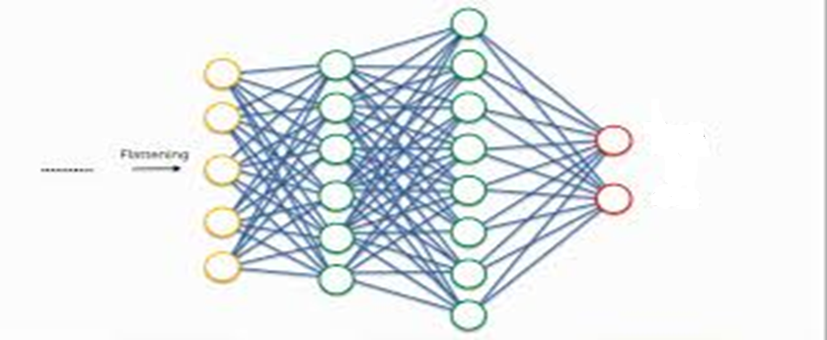
Cont... 4. Fully Connected Layer Neurons in a fully connected layer have full connections to all the activations in the previous layer. Combining more neurons to predict more accurately.

Slide 15
Cont...
2. Random Forest
Random forest is a Supervised Machine Learning Algorithm that is used widely in Classification and Regression problems.
It reduces the overfitting problems.
It builds decision trees on different samples and takes their majority vote for classification.
In this project we are predicting Rainfall, Temperature, Crops by using random forest model.

Slide 16
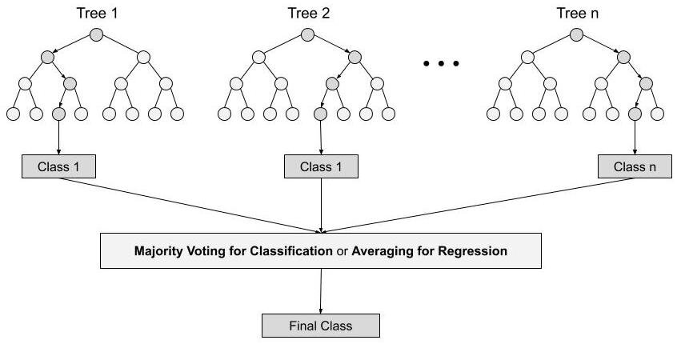
Cont...

Slide 17
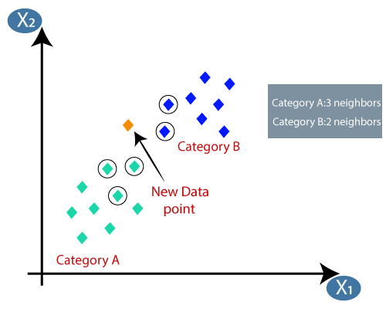
3. KNN
A refinement of the k-NN classification algorithm is to weigh the contribution of each of the k neighbors according to their distance to the query point, giving greater weight to closer neighbors.
The KNN classifier suggesting the shop details based on the nearest distance.
d=sqrt((x2-x1)²+(y2-y1)²)

Slide 18
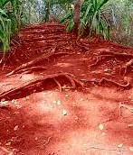
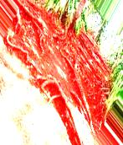
Results
Resized Image
Rotated Image

Slide 19
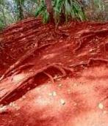
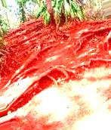
Results
Zoom Image
Brighter Image

Slide 20
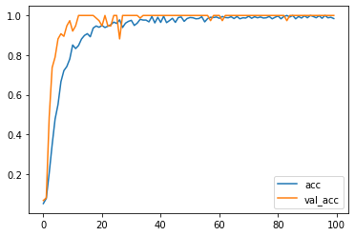
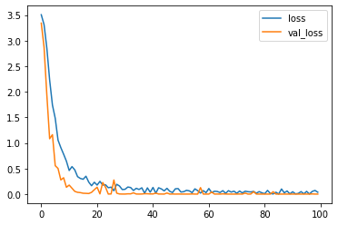
Results
CNN Accuracy Graph
CNN Loss Graph

Slide 21


Results
Registration page
Login page

Slide 22
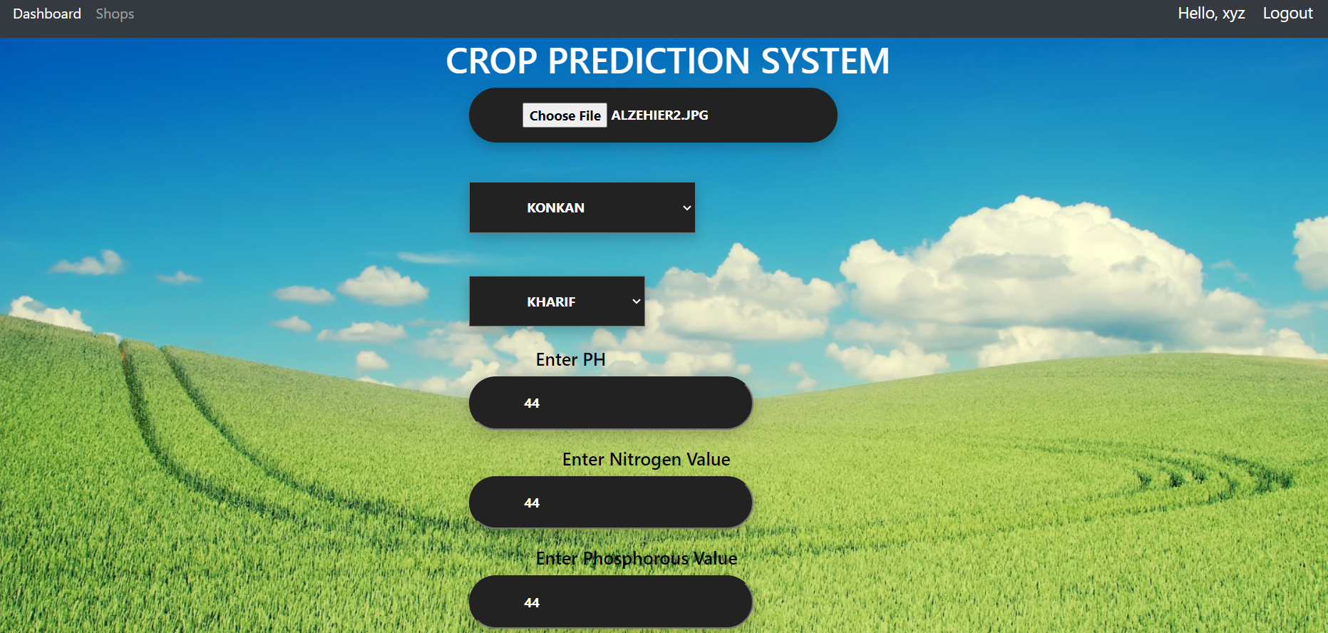
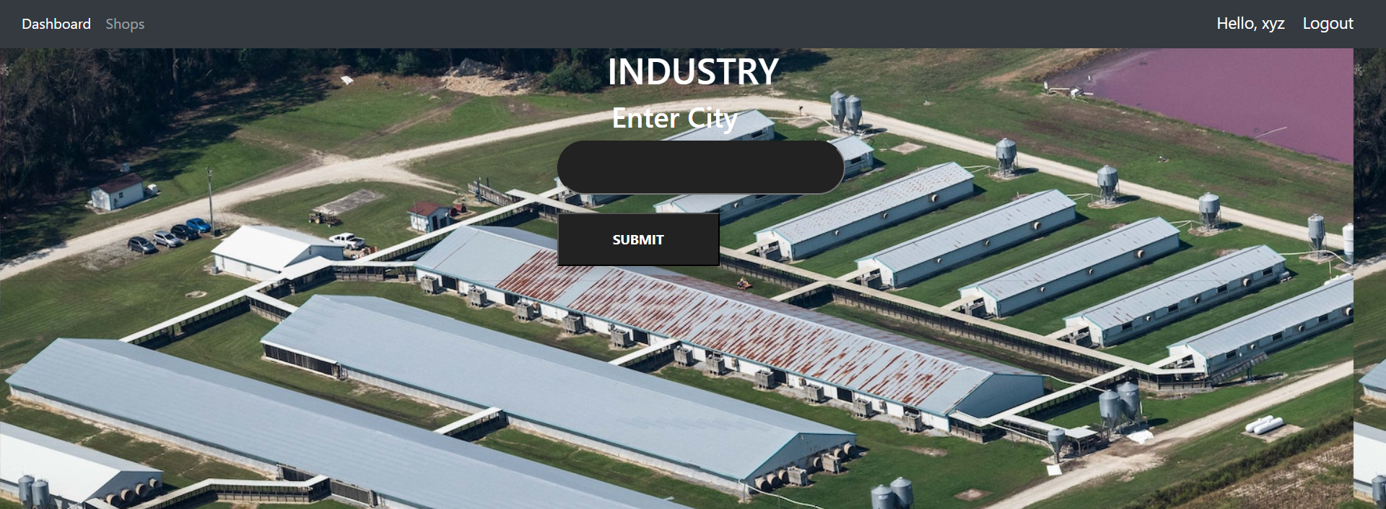
Results
Crop Home page
Industry Home page

Slide 23
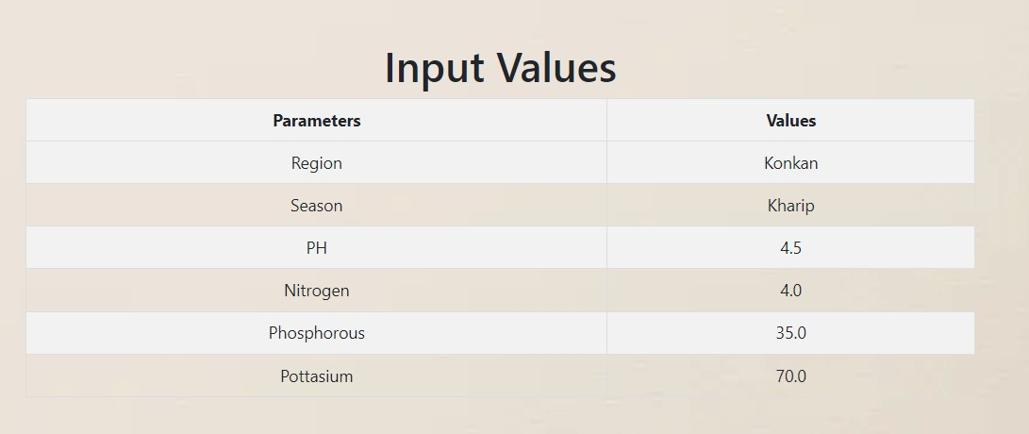
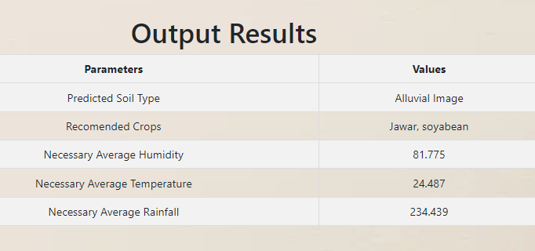
Results

Slide 24
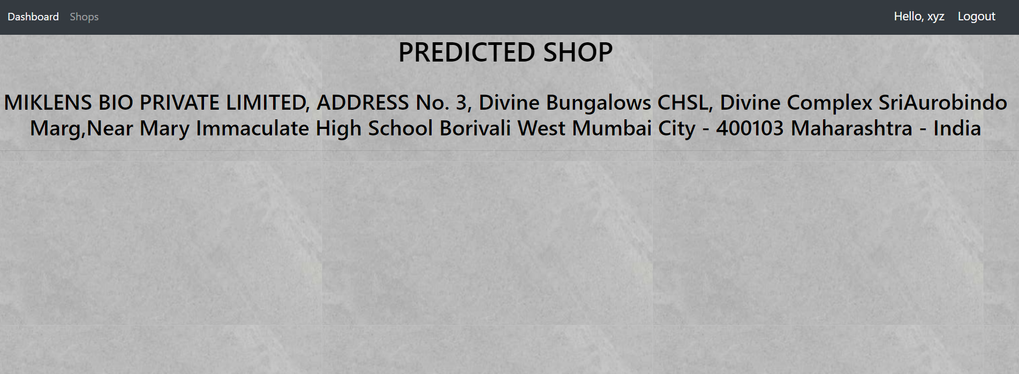

Results
Recommend the shop
Recommend the shop

Slide 25
Limitations
If input image is not a soil image still system gives the crop recommendation
For KNN model we need handcrafted database as no such database of industry location is available.
For locating the nearest market, inputted location should be precise and is case-sensitive.
Frontend is developed in html & css and SQlite 3 database is used to store only user’s username and email id.
System does not save the output page in database, rather than saves the output page as a image in local storage

Slide 26
Conclusion
This proposed system concludes that the deep learning and machine learning algorithms can be used for the recommendation of crop with the accuracy up to 92 %. This system uses CNN algorithm to classify the input soil image into the 4
categories (Red, clay, Alluvial, Black) and using the random forest algorithm the system predicts the crop. KNN algorithm can be used to predict the nearest industry or shop based on the users current location very efficiently.

Slide 27
REFRENCES
[1] A comprehensive review on soil classification using deep learning and computer vision techniques Pallavi Srivastava1 & Aasheesh Shukla1 & Atul Bansal1
[2] Crop Prediction Model Using Machine Learning Algorithms Ersin Elbasi * , Chamseddine Zaki, Ahmet E. Topcu, Wiem Abdelbaki, Aymen I. Zreikat , Elda Cina , Ahmed Shdefat and Louai Saker.
[3] R. Reshma, V. Sathiyavathi and T. Sindhu et al. “IoT based Classification Techniques for Soil Content Analysis and Crop Yield Prediction” Proceedings of the Fourth International Conference on I-SMAC (IoT in Social, Mobile, Analytics and Cloud) (I-SMAC).
[4] Sonal Jain, Dharavath Ramesh, “Machine Learning convergence for weather based crop selection” 2020 IEEE International Students’ Conference on Electrical, Electronics and Computer Science.

Slide 28
Cont…
[5] G. Mariammal , A. Suruliandi , S. P. Raja , and E. Poongothai “Prediction of
Land Suitability for Crop Cultivation Based on Soil and Environmental
Characteristics Using Modified Recursive Feature Elimination Technique With
Various Classifiers” IEEE TRANSACTIONS ON COMPUTATIONAL SOCIAL
SYSTEMS.

Slide 29
Thank You

